Slide 1

CHAPTER 9
COUNTING AND PROBABILITY
Copyright © Cengage Learning. All rights reserved.

Slide 2

9.2
Possibility Trees and the Multiplication Rule
Copyright © Cengage Learning. All rights reserved.

Slide 3
Possibility Trees and the Multiplication Rule
A tree structure is a useful tool for keeping systematic track of all possibilities in situations in which events happen in order. The following example shows how to use such a structure to count the number of different outcomes of a tournament.

Slide 4
Example 9.2.1 – Possibilities for Tournament Play
Teams A and B are to play each other repeatedly until one wins two games in a row or a total of three games. One way in which this tournament can be played is for A to win the first game, B to win the second, and A to win the third and fourth games. Denote this by writing A–B–A–A.
a. How many ways can the tournament be played?
b. Assuming that all the ways of playing the tournament are equally likely, what is the probability that five games are needed to determine the tournament winner?

Slide 5
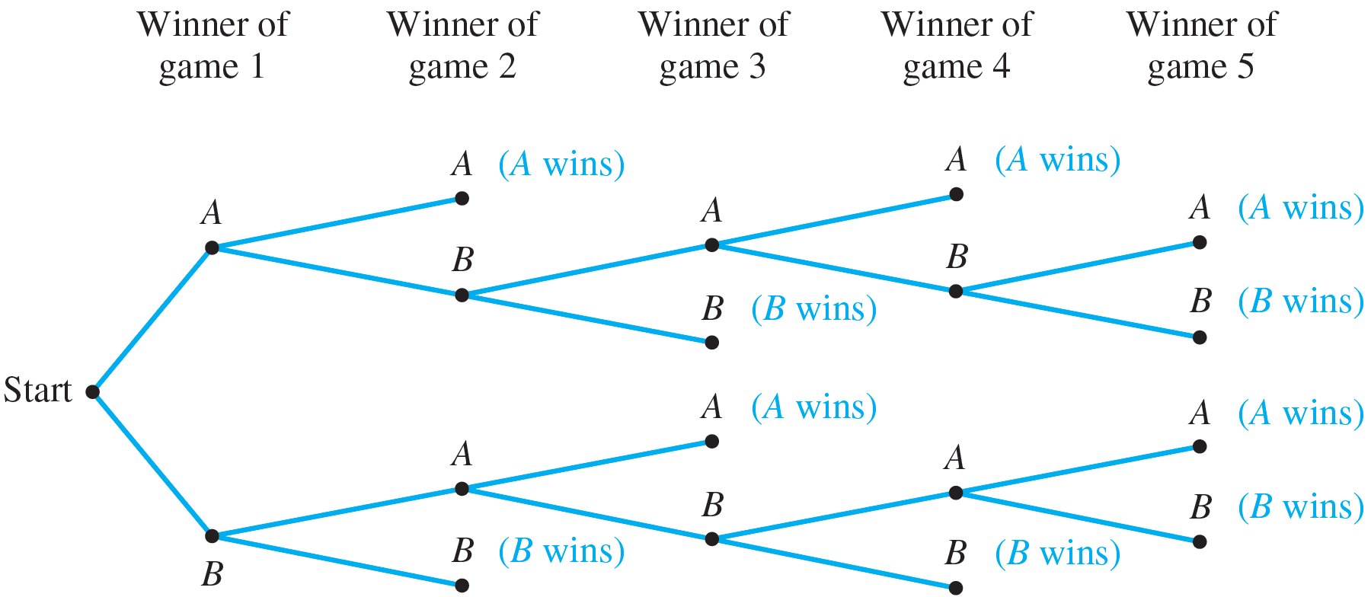
Example 9.2.1 – Solution
a. The possible ways for the tournament to be played are represented by the distinct paths from “root” (the start) to “leaf” (a terminal point) in the tree shown sideways in Figure 9.2.1. The label on each branching point indicates the winner of the game. The notations in parentheses indicate the winner of the tournament.
The Outcomes of a Tournament
Figure 9.2.1

Slide 6
Example 9.2.1 – Solution
continued
The fact that there are ten paths from the root of the tree to its leaves shows that there are ten possible ways for the tournament to be played. They are (moving from the top down): A–A, A–B–A–A, A–B–A–B–A, A–B–A–B–B, A–B–B, B–A–A, B–A–B–A–A, B–A–B–A–B, B–A–B–B, and B–B.
In five cases A wins, and in the other five B wins. The least number of games that must be played to determine a winner is two, and the most that will need to be played is five.

Slide 7
Example 9.2.1 – Solution
continued
b. Since all the possible ways of playing the tournament listed in part (a) are assumed to be equally likely, and the listing shows that five games are needed in four different cases (A–B–A–B–A, A–B–A–B–B, B–A–B–A–B, and B–A–B–A–A), the probability that five games are needed is 4 ∕ 10 = 2 ∕ 5 = 40%.

Slide 8
The Multiplication Rule

Slide 9
The Multiplication Rule
Consider the following example. Suppose a computer installation has four input/output units (A, B, C, and D) and three central processing units (X, Y, and Z). Any input/output unit can be paired with any central processing unit. How many ways are there to pair an input/output unit with a central processing unit?
To answer this question, imagine the pairing of the two types of units as a two-step operation:
Step 1: Choose the input/output unit.
Step 2: Choose the central processing unit.

Slide 10
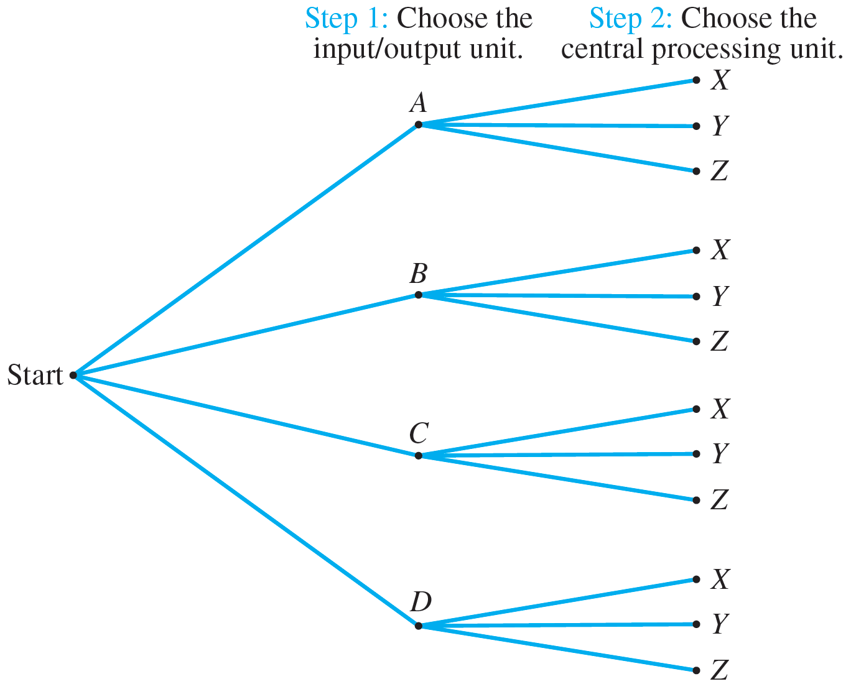
The Multiplication Rule
The possible outcomes of this operation are illustrated in the possibility tree of Figure 9.2.2.
Pairing Objects Using a Possibility Tree
Figure 9.2.2

Slide 11
The Multiplication Rule
The topmost path from “root” to “leaf” indicates that input/output unit A is to be paired with central processing unit X. The next lower branch indicates that input/output unit A is to be paired with central processing unit Y. And so forth.
Thus the total number of ways to pair the two types of units is the same as the number of branches of the tree, which is
3 + 3 + 3 + 3 = 4 · 3 = 12.

Slide 12
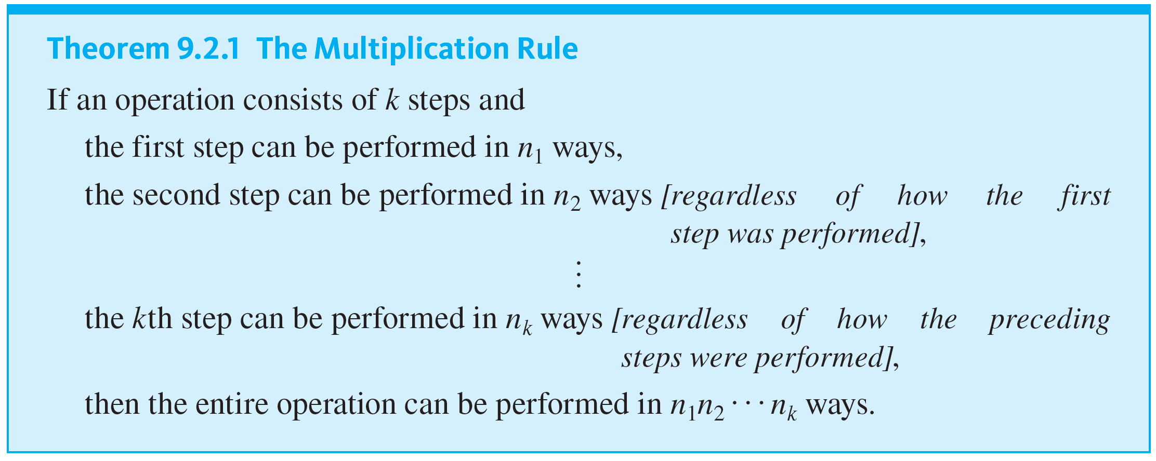
The Multiplication Rule
The idea behind this example can be used to prove the following rule. A formal proof uses mathematical induction and is left to the exercises.

Slide 13
Example 9.2.2 – Counting Personal Identification Numbers (PINs)
A certain personal identification number (PIN) is required to be a sequence of any four symbols chosen from the 26 uppercase letters in the Roman alphabet and the ten digits.
a. How many different PINs are possible if repetition of symbols is allowed?
b. How many different PINs are possible if repetition of symbols is not allowed?
c. What is the probability that a PIN does not have a repeated symbol assuming that all PINs are equally likely?

Slide 14
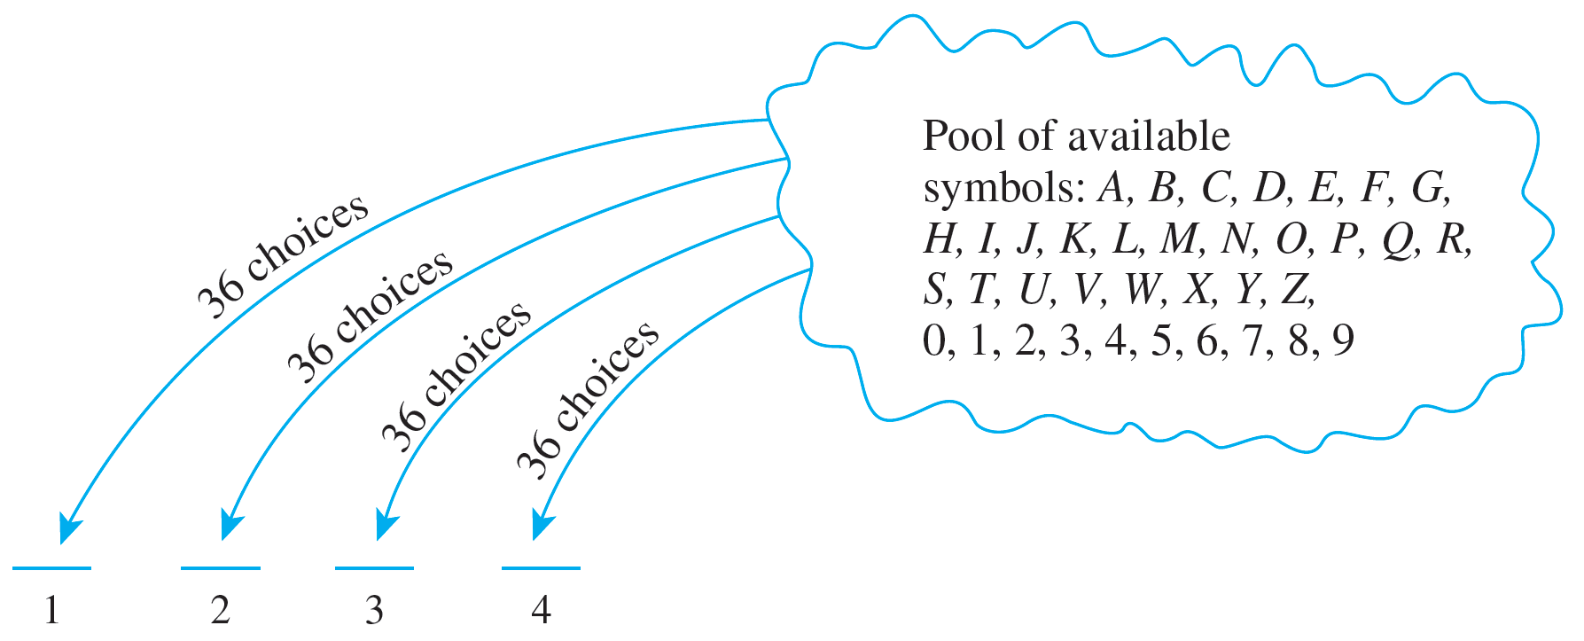
Example 9.2.2 – Solution
a. Some possible PINs are RCAE, 3387, B92B, and so forth. You can think of forming a PIN as a four-step operation where each step involves placing a symbol into one of four positions, as shown below.

Slide 15

Example 9.2.2 – Solution
continued
Step 1: Choose a symbol to place in position 1.
Step 2: Choose a symbol to place in position 2.
Step 3: Choose a symbol to place in position 3.
Step 4: Choose a symbol to place in position 4.
There is a fixed number of ways to perform each step, namely 36, regardless of how preceding steps were performed. And so, by the multiplication rule, there are 36 · 36 · 36 · 36 =
= 1,679,616 PINs in all.

Slide 16
Example 9.2.2 – Solution
continued
b. Again think of forming a PIN as a four-step operation: Choose the first symbol, then the second, then the third, and then the fourth.
There are 36 ways to choose the first symbol, 35 ways to choose the second (since the first symbol cannot be used again), 34 ways to choose the third (since the first two symbols cannot be reused), and 33 ways to choose the fourth (since the first three symbols cannot be reused).

Slide 17
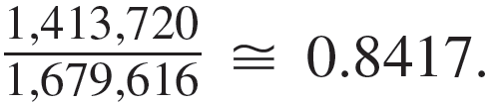
Example 9.2.2 – Solution
continued
Thus, the multiplication rule can be applied to conclude that there are 36 · 35 · 34 · 33 = 1,413,720 different PINs with no repeated symbol.
c. By part (b) there are 1,413,720 PINs with no repeated symbol, and by part (a) there are 1,679,616 PINs in all. Thus the probability that a PIN chosen at random
contains no repeated symbol is
In other words, approximately 84% of PINs have no repeated symbol.

Slide 18
Example 9.2.5 – Counting the Number of Iterations of a Nested Loop
Consider the following nested loop:
for i := 1 to 4
for j := 1 to 3
[Statements in body of inner loop.
None contain branching statements
that lead out of the inner loop.]
next j
next i
How many times will the inner loop be iterated when the algorithm is implemented and run?

Slide 19
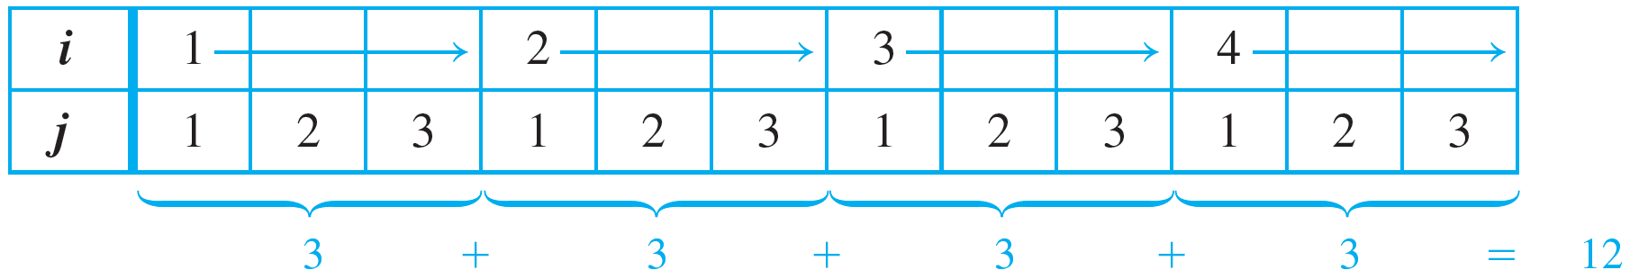
Example 9.2.5 – Solution
The outer loop is iterated four times, and during each iteration of the outer loop, there are three iterations of the inner loop. Hence by the multiplication rule, the total number of iterations of the inner loop is 4 · 3 = 12.
This is illustrated by the trace table below.

Slide 20
Permutations

Slide 21
Permutations
A permutation of a set of objects is an ordering of the objects in a row. For example, the set of elements a, b, and c has six permutations.
abc acb cba bac bca cab
In general, given a set of n objects, how many permutations does the set have?

Slide 22
Permutations
Imagine forming a permutation as an n-step operation:
Step 1: Choose an element to write first.
Step 2: Choose an element to write second.
⋮ ⋮
Step n: Choose an element to write nth.
Any element of the set can be chosen in step 1, so there are n ways to perform step 1. Any element except that chosen in step 1 can be chosen in step 2, so there are n − 1 ways to perform step 2.

Slide 23
Permutations
In general, the number of ways to perform each successive step is one less than the number of ways to perform the preceding step. At the point when the nth element is chosen, there is only one element left, so there is only one way to perform step n.
Hence, by the multiplication rule, there are
ways to perform the entire operation.

Slide 24

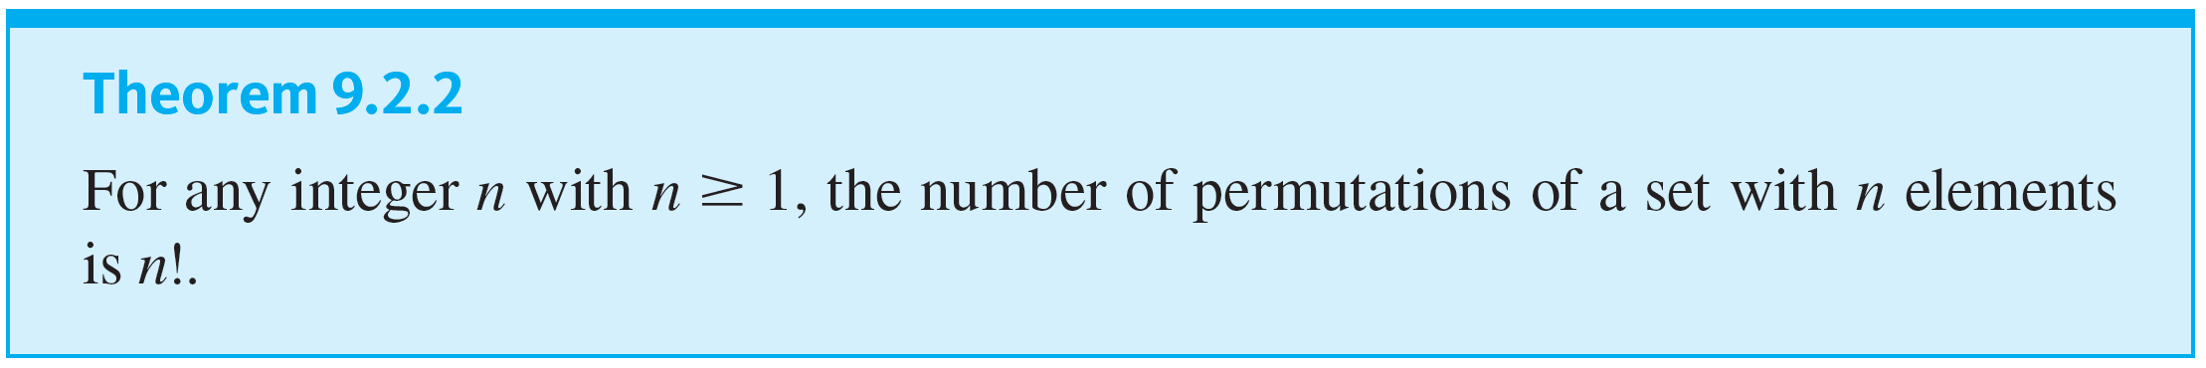
Permutations
permutations of a set of n elements. This reasoning is summarized in the following theorem. A formal proof uses mathematical induction and is left as an exercise.
In other words, there are

Slide 25
Example 9.2.7 – Permutations of the Letters in a Word
a. How many ways can the letters in the word COMPUTER be arranged in a row?
b. How many ways can the letters in the word COMPUTER be arranged if the letters CO must remain next to each other (in order) as a unit?
c. If letters of the word COMPUTER are randomly arranged in a row, what is the probability that the letters CO remain next to each other (in order) as a unit?

Slide 26



Example 9.2.7 – Solution
a. All eight letters in the word COMPUTER are distinct, so the number of ways in which you can arrange the letters equals the number of permutations of a set of eight elements. This equals
b. If the letter group CO is treated as a unit, then there are effectively only seven objects that are to be arranged in a row.
Hence there are as many ways to write the letters as there are permutations of a set of seven elements, namely,

Slide 27
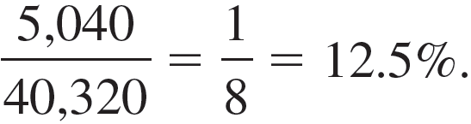
Example 9.2.7 – Solution
continued
c. When the letters are arranged randomly in a row, the total number of arrangements is 40,320 by part (a), and the number of arrangements with the letters CO next to each other (in order) as a unit is 5,040.
Thus the probability is

Slide 28
Permutations of Selected Elements

Slide 29
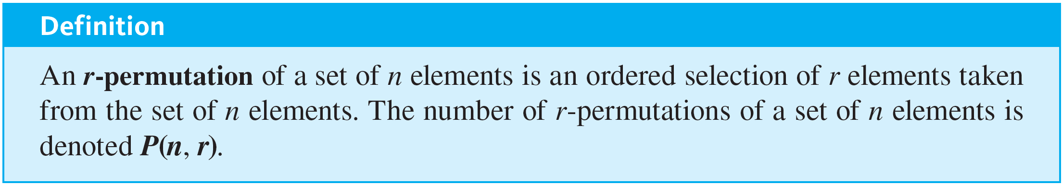
Permutations of Selected Elements
Given the set {a, b, c}, there are six ways to select two letters from the set and write them in order.
ab ac ba bc ca cb
Each such ordering of two elements of {a, b, c} is called a 2-permutation of {a, b, c}.

Slide 30
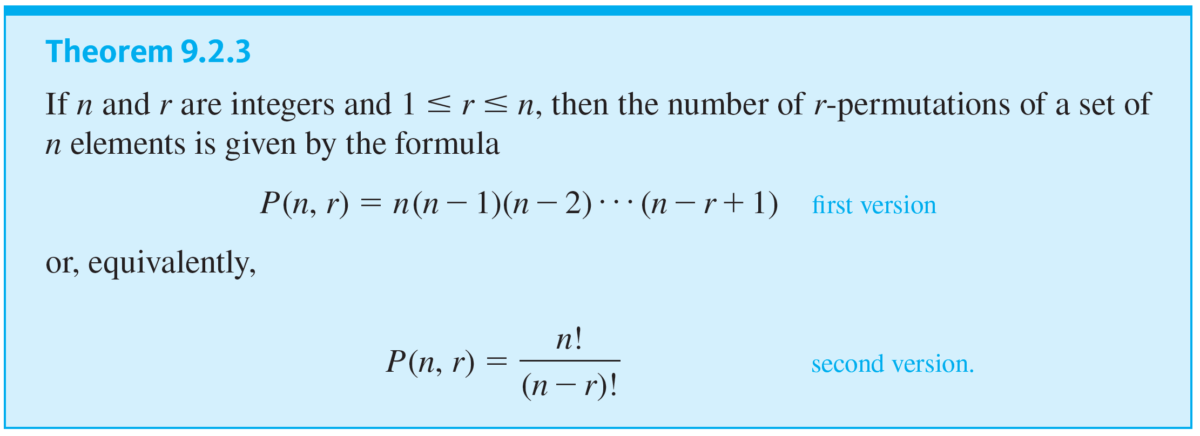
Permutations of Selected Elements

Slide 31
Example 9.2.9 – Evaluating r-Permutations
a. Evaluate P(5, 2).
b. How many 4-permutations are there of a set of seven objects?
c. How many 5-permutations are there of a set of five objects?

Slide 32
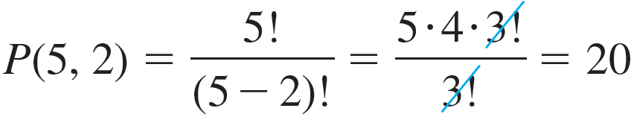
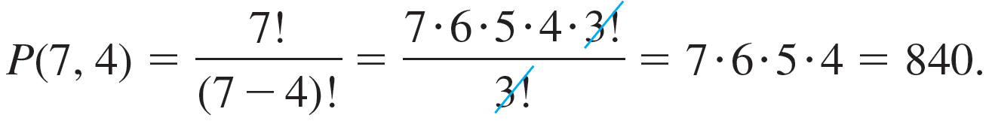
Example 9.2.9 – Solution
a.
b. The number of 4-permutations of a set of seven objects is

Slide 33
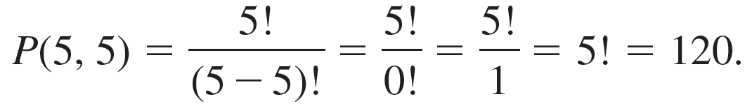

Example 9.2.9 – Solution
continued
c. The number of 5-permutations of a set of five objects is
as 1 makes this calculation come out as it should, for the number of 5-permutations of a set of five objects is certainly equal to the number of permutations of the set.
Note that the definition of

